Slide 1
DIAMOND MARKET ANALYSIS FOR GAME VALUE ANALYTICS
MUCHOKI JACOB
3RD JUNE 2025

Slide 2
INTRODUCTION
Background The diamond industry is a multibillion-dollar global market driven by quality, rarity, and consumer perception. Accurately pricing diamonds is essential for profitability, transparency, and competitiveness. Industry relevance With increasing online jewelry sales and customer awareness, there is a growing need for data-driven pricing. Understanding how features like carat, cut, color, and clarity influence price can help businesses price more competitively and strategically. Objective of the analysis To explore key drivers of diamond prices to detect patterns, outliers, and trends in a dataset of over 50,000 diamonds to deliver actionable insights using Python, pandas, and seaborn to provide data visualizations and a business-friendly interpretation for decision-making

Slide 3
PROBLEM STATEMENT
Diamond prices vary based on features like carat, cut, color, and clarity.
This analysis aims to identify which features most influence price and uncover patterns that can guide better pricing decisions.
In this analysis, we are predicting the price of a diamond using features such as carat, cut, color, and clarity. This helps us understand which features have the most influence on price and supports better decision-making in diamond valuation.

Slide 4
DATA DESCRIPTION
Source of data- it’s an inbuilt seaborn dataset
Features/variable-price,cut,clarity,colour,depth,table and dimensions(x,y,z)
Number of records- 53940 rows and 10 columns
Missing values –none
Duplicates- 146 duplicated rows
Data_types- Categorical(cut,colour and clarity) , int(price) , float(carat,table,dimensions(x,y,z))

Slide 5
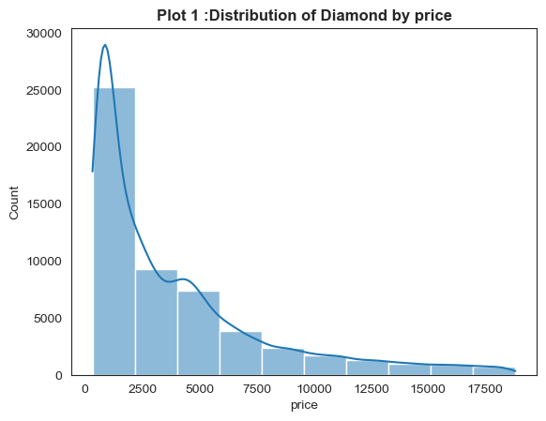
EDA:Distribution of Diamond by price
Right-Skewed Distribution (Positively Skewed)*
Most diamonds are low-priced, clustered towards the left (under 2,500).
A few diamonds are very expensive, causing a long tail on the right.
The majority of Diamonds Are Affordable
Over 25,000 diamonds are priced below 2,500.
The count drops sharply as the price increases.
Rare Expensive Diamonds
Diamonds priced above 10,000 are relatively rare.
Most diamonds are small and have good but not perfect quality, so they fall in the
2,500 price range. Diamonds that are very big and perfect are very rare, so we see fewer of them, and that’s why there are fewer diamonds with super high prices.

Slide 6
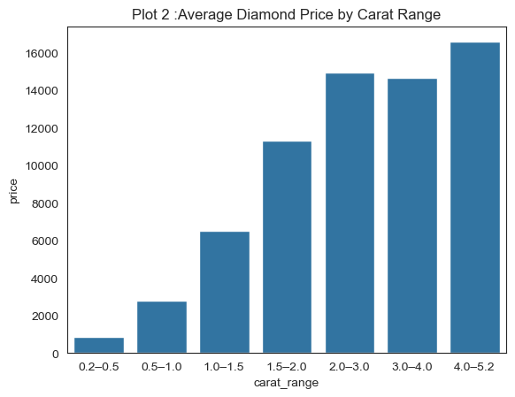
EDA:Average Diamond Price by Carat Range
The plot reveals a significant relationship between carat and price. As the carat range increases, the average diamond price rises noticeably. This indicates that diamonds with higher carat weights tend to be significantly more expensive. The trend suggests that larger diamonds are more valuable, and the price increase becomes more pronounced in the higher carat ranges, reflecting their rarity and market demand.

Slide 7
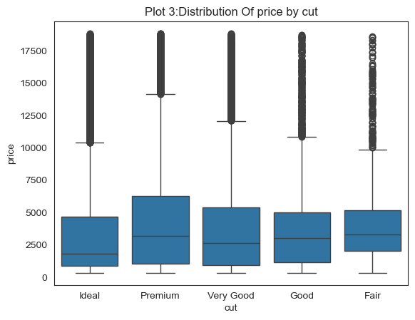
EDA:Distribution Of price by cut
Although Ideal is considered the highest-quality cut, it has fewer high-priced diamonds.This suggests that cut quality alone doesn’t determine price.Factors like carat weight, clarity, and color significantly influence diamond value.As a result, even Fair cuts may be priced higher when combined with premium characteristics.

Slide 8
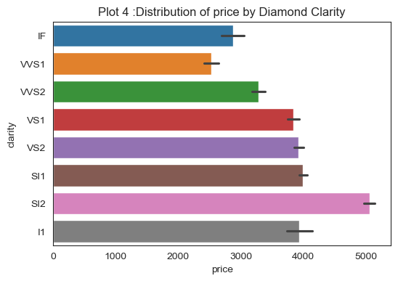
EDA:Distribution of price by Diamond Clarity
While the clarity levels are arranged from the most clear to the least, the pricing trend does not strictly follow this order. Interestingly, a lower clarity level (such as SI2) shows the highest average price. This indicates that clarity alone does not determine diamond price — factors like carat size, cut quality, and color significantly influence the final value.

Slide 9
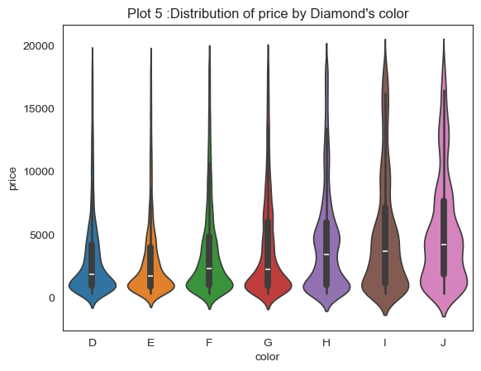
EDA:Distribution of price by Diamond's color
Trend as Price Increases:
Across all color grades, the violin shapes narrow significantly at higher prices (e.g., above Ksh 13,000 to 20,000), indicating that expensive diamonds are much less common in the dataset.
The density is concentrated at the bottom of each violin, confirming that affordable diamonds are the majority in all color categories. Insights: High-quality colors (like D) may be less available or purchased less frequently, even if they tend to be more expensive.
Lower-quality colors (like J) are more common, especially at lower price points, possibly due to higher demand for affordable options.
The market is skewed towards affordability, with very few diamonds reaching very high prices.

Slide 10
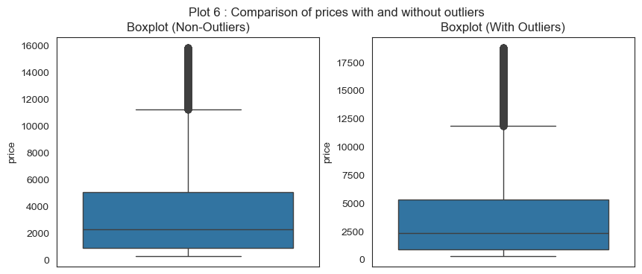
EDA:Comparison of prices with and without outliers
The boxplot comparison shows how outliers affect the distribution of diamond prices. When outliers are included, the plot becomes stretched, making it hard to see the main price range. After removing outliers, the boxplot clearly shows that most diamond prices are concentrated below $ 5,000. This helps us better understand the typical price distribution.

Slide 11
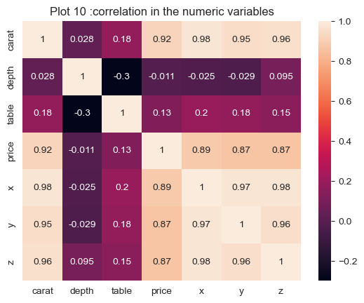
EDA:Correlation in the numeric variables
From the heatmap, we observe that the most strongly correlated factors with diamond price are carat and the physical dimensions (x, y, and z), which means that size and weight are key determinants of price. In contrast, features like depth and table show weak or no significant correlation with price, suggesting they are not major factors in determining a diamond’s value.

Slide 12
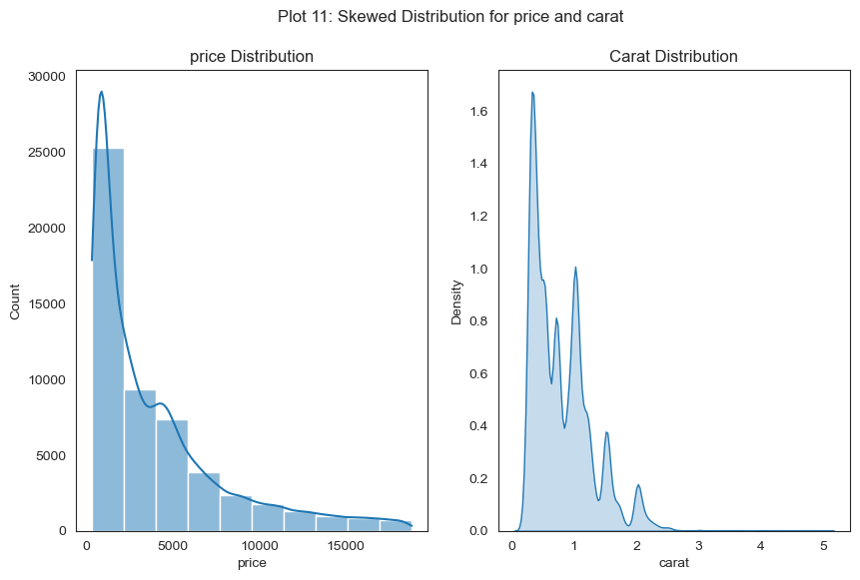
EDA:Skewed Distribution for price and carat
From the visualizations, both price and carat distributions are positively skewed. This means that most diamonds in the dataset are affordable and lightweight, with a smaller number of diamonds being very expensive or having higher carat values. The long right tails in both plots indicate that while high-priced and large-carat diamonds exist, they are much less common compared to lower-priced, smaller diamonds.

Slide 13
METHODOLOGY
The diamonds dataset was sourced from the Seaborn library.
Initial data cleaning steps included:
Removing duplicate records
Confirming the absence of missing values
Univariate analysis was performed to examine the distribution of individual variables such as:
Carat
cut
price
Bivariate analysis explored relationships between variables.
Visualizations used in the analysis included:
Boxplots
Histograms
Correlation matrices
The EDA provided insights into the relationships between physical diamond characteristics and their prices.
Findings from EDA were used to inform future statistical modeling and hypothesis testing.

Slide 14
Result & Insights:
The most strongly correlated factors with diamond price are:
Carat weight
Physical dimensions (x, y, z)
This shows that size and weight are major determinants of price.
Depth and table have weak or no significant correlation with price.
Cut quality alone does not strongly influence price.
Clarity and color also have a significant impact on diamond value.
Diamonds with smaller carat weight are more commonly available.
The most common diamond prices are around those with lesser price
Diamonds with high carat are very expensive and less frequent in the dataset where as those with less carat are the most available ones

Slide 15
Patterns and Relationships:
Most diamonds have a carat range between 0.2 – 1.0, making them the most common size.
The most frequent price for diamonds is around $2,500 USD.
There is a strong positive relationship between carat size and price — bigger diamonds cost more.
Physical dimensions (x, y, z) also show a strong correlation with price.
Features like depth and table have little or no effect on price.

Slide 16
Recommendation:
What should the stakeholders do based on the analysis:
Actionable Insights derived from data
1.Prioritize Carat Size in Pricing and Marketing
Carat and size are the strongest predictors of price — focus on these when setting prices and advertising diamonds
2.Stock More Diamonds in the 0.2 – 1.0 Carat Range
This range is most common and affordable (~$2,500 USD), so increasing inventory here will likely meet higher customer demand.
3.Do Not Overemphasize Cut Alone
Since cut does not significantly affect price on its own, focus instead on clarity, color, and carat when determining value.
Carat weight is the strongest driver of price → Focus on promoting diamonds by their carat size to align with pricing expectations.
Diamonds in the 0.2 – 1.0 carat range dominate the market → Prioritize stocking and targeting marketing for this most in-demand segment.
Most diamonds are priced around $2,500 USD → Price new inventory competitively within this range to attract more buyers.
Depth and table have minimal impact on price → Don’t overemphasize these in marketing or valuation — they are not key value indicators.
Clarity and color significantly influence value → Use high clarity and color grades to justify premium pricing.

Slide 17
Conclusion
Problem Recap: The goal was to understand the key factors that influence diamond prices using exploratory data analysis (EDA) on the Seaborn diamonds dataset.
Approach Taken: The dataset was cleaned by removing duplicates and checking for missing values. Univariate and bivariate analyses were conducted using histograms, boxplots, and correlation matrices to explore patterns and relationships between features such as carat, cut, clarity, and price.
Key Takeaways:
Carat size and physical dimensions (x, y, z) are the strongest predictors of price.
Depth and table have little to no influence on price.
Cut alone does not determine value; clarity and color also significantly impact price.
Most diamonds fall within the 0.2 – 1.0 carat range and are priced around $2,500 USD.
Final Remarks
This analysis highlights the importance of data-driven decision-making in the diamond industry. Stakeholders can use these insights to better price, market, and stock their products, focusing on features that truly influence value. Future work can involve predictive modeling to forecast prices or apply machine learning for automated valuation.

